Slide 1
UNIT II
Theory of Production

Slide 2
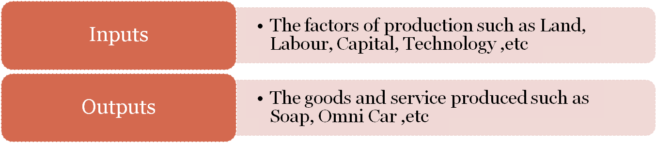
Theory of Production
Production is a process that create/adds value or utility
It is the process in which the inputs are converted in to outputs.

Slide 3

Production Function
Production function means the functional relationship between inputs and outputs in the process of production.
It is a technical relation which connects factors inputs used in the production function and the level of outputs
Q = f (Land, Labour, Capital, Organization, Technology, etc)

Slide 4
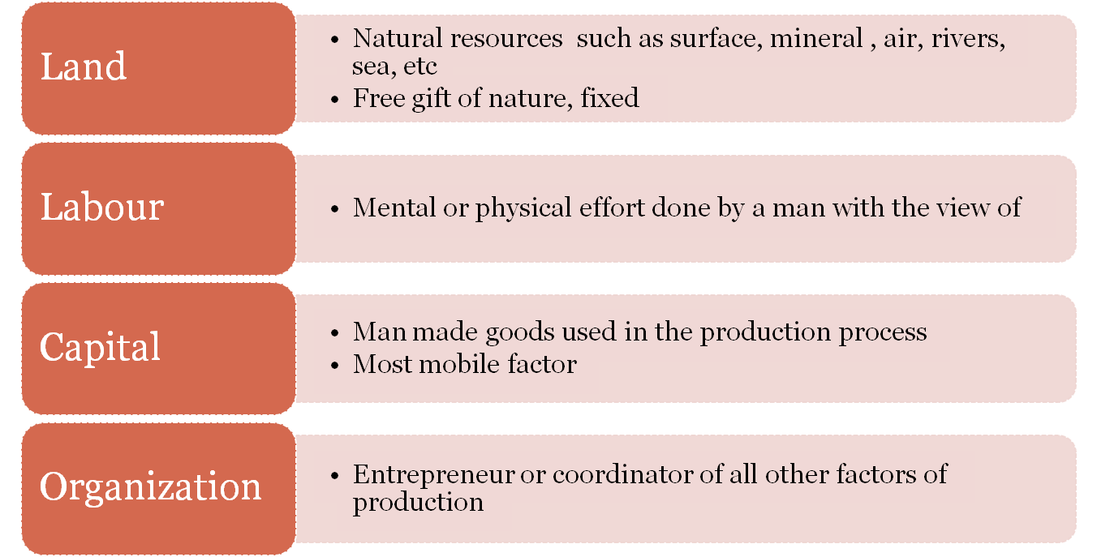
Factors of Production

Slide 5
Inputs : Fixed inputs and Variable inputs
The factors of production that is used to carry out the production is called inputs.
Land, Labour, Capital, Organizer, Technology, are the example of inputs
Inputs Factors
Variable inputs
Fixed Inputs

Slide 6
Inputs : Fixed inputs and Variable inputs
Fixed inputs Variable inputs
Remain the same in the short period .
At any level of out put, the amount is remain the same.
The cost of these inputs are called Fixed Cost
Examples:- Building, Land etc
( In the long run fixed inputs are become varies)
In the long run all factors of production are varies according to the volume of outputs.
The cost of variable inputs is called Variable Cost
Example:- Raw materials, labour, etc

Slide 7
Various concepts of production
Total Product – Total quantity of output produced
Average Product- Ratio of Total Product and one variable inputs
Average Product = Total Product/ Units of Variable Factor Input
Marginal Product – The rate of change of out put as a
result changes in one variable input
Marginal Product = Change in Output/ Change in Input

Slide 8


Short run Production Function with Labour as Variable factor
Labour (L)
Capital (K)
Total Output (TP)
Average Product (AP)
Marginal Product (MP)
0
1
2
3
4
5
6
7
8
9
10
10
10
10
10
10
10
10
10
10
10
10
0
10
30
60
80
95
108
112
112
108
100

Slide 9
Laws of Production Function
i
Law of Variable proportion- Law of Diminishing Return ( Short run production function with at least one input is variable)
ii
Law of Return to scales – Long run production function with all inputs factors are variable.

Slide 10
Law of variable proportion: Short run Production Function
•
Explains the short run production function
Production function with at least one variable factor keeping the quantities of others inputs as a Fixed.
Show the input-out put relation when one inputs is variable
“If one of the variable factor of production is used more and more unit,keeping other inputs fixed, the total product(TP) will increase at an increasing rate in the first stage, and in the second stage TP continue to increase but at diminishing rate and eventually TP decrease.”

Slide 11


Short run Production Function with Labour as Variable factor
Labour (L)
Capital (K)
Total Output (TP)
Average Product
(AP)
Marginal Product (MP)
0 | 10 | 0 | -
1 | 10 | 10 | ₁₀ 10
2 | 10 | 30 | ₁₅ 20 First
3 | 10 | 60 | ₂₀ 30 Stage
4 | 10 | 80 | ₂₀ 20
5 | 10 | 95 | ₁₉ 15 Second
6 | 10 | 108 | ₁₈ 13 stage
7 | 10 | 112 | 16 ⁴
8 | 10 | 112 | 14 ⁰
9 | 10 | 108 | ₁₂ -4 Third
10 | 10 | 100 | ₁₀ -8 stage

Slide 12



D
112
Output per
month
Total Product
C
60
B
A
Labor per month
3 4
8
30
E
20
Average product
10
3 4
Labor per month
8
Marginal product

Slide 13
Stages in Law of variable proportion
First Stage: Increasing return
▪
▪
▪
▪
TP increase at increasing rate till the end of the stage.
AP also increase and reaches at highest point at the end of the stage. MP also increase at it become equal to AP at the end of the stage.
MP>AP
Second Stage: Diminishing return
TP increase but at diminishing rate and it reach at highest at the end of the stage.
AP and MP are decreasing but both are positive.
MP become zero when TP is at Maximum, at the end of the stage
MP<AP.
Third Stage: Negative return
▪
▪
TP decrease and TP Curve slopes downward
As TP is decrease MP is negative. AP is decreasing but positive.

Slide 14
The Three Stages of Production
In the short run, rational firms should only be operating in Stage II.
Why Stage II?
Why not Stage III?
Firm uses more variable inputs to produce less output!
Why not Stage I?
Underutilizing fixed capacity.
Can increase output per unit by increasing the amount of the variable input.

Slide 15
Where should rational firm produce?

Slide 16
Where should rational firm produce?
Stage I: MP is above AP implies an increase in input increases output in greater proportion.
The firm is not making the best possible use of the fixed factor.
So, the firm has an incentive to increase input until it crosses over to stage II.
Stage III: MP is negative implies contribution of additional labor is negative so the total output decreases .
In this case it will be unwise to employ an additional labor.

Slide 17
Stage II: MP is below AP implies increase in input increases output in lesser proportion.
A rational producer/firm should produce in stage II.
But where exactly the firm will operate within stage II cannot be determined only on the basis of the product curves.
We need information about input costs and price of output.

Slide 18
2. Law of return to scales: Long run Production Function
Explains long run production function when the inputs are changed in the same proportion.
Production function with all factors of production variable.
Shows the input-out put relation in the long run with all inputs are variable.
“Return to scale refers to the relationship between change in output and proportionate changes
in all factors of production ”

Slide 19
Law of return to scales: Long run Production Function
Labour | Capital | TP | MP
2 | 1 | 8 | 8
4 | 2 | 18 | 10
6 | 3 | 30 | 12
8 | 4 | 40 | 10
10 | 5 | 50 | 10
12 | 6 | 60 | 10
14 | 7 | 68 | 8
16 | 8 | 74 | 6
18 | 9 | 78 | 4
Increasing returns to scale
Constant returns to scale
Decreasing returns to scale

Slide 20
Law of return to scales: Long run Production Function
•
Inputs 10% increase – Outputs 15% increase
Increasing returns to scale
Inputs 10% increase – Outputs 10% increase
Constant returns to scale
Inputs 10% increase – Outputs 5% increase
Decreasing returns to scale

Slide 22
Linearly Homogeneous production
function
In the long run all inputs are variable. The production function is Linearly homogeneous if all inputs factors are increased in the same proportions and the output is
increased in the same proportion.
Constant returns to scale Homogeneous production function Inputs increased 10% => output increased 10%
A Linearly homogeneous Production function Q = f (L, K )
if labour and capital increased 10% then output increased the same 10%

Slide 23
Homogeneous production function
In the long run all inputs are variable. The production function is homogeneous if all inputs factors are increased in the same proportions in order to change
the outputs.
A Production function Q = f (L, K )
Q^ = f (L+L.10%, K+K.10% )-
Inputs increased same proportion
Increasing returns to scale
Inputs increased 10% => output increased 15%
Constant returns to scale Inputs increased 10% => output increased 10%
Decreasing returns to scale Inputs increased 10% => output increased 8%

Slide 24
Homogeneous production function
In the long run all inputs are variable. The production function is homogeneous if all inputs factors are increased in the same proportions in order to change
the outputs.
A Production function Q = f (L, K )
Q1 = f (L+L.10%, K+K.10% )-
Inputs increased same proportion
Increasing returns to scale
Inputs increased 10% => output increased 15%
Constant returns to scale Inputs increased 10% => output increased 10%
Decreasing returns to scale Inputs increased 10% => output increased 8%

